Slide 1
CSE 430 Software Testing and Quality Assurance

Slide 2
Lecture 07

Slide 3
Dynamic Testing
Black-Box Testing Techniques

Slide 4
Equivalence Class Testing
input domain for testing is too large to test every input
we can divide or partition the input domain based on a common feature or a class of data.
Equivalence partitioning is a method for deriving test cases wherein classes of input conditions called equivalence classes are identified such that each member of the class causes the same kind of processing and output to occur.

Slide 5
Equivalence Class Testing (cont.)
Thus, instead of testing every input, only one test case from each partitioned class can be executed. It means only one test case in the equivalence class will be sufficient to find errors.
If one test case in an equivalence class detects a bug, all other test cases in that class have the same probability of finding bugs.
Therefore, instead of taking every value in one domain, only one test case is chosen from one class.

Slide 6
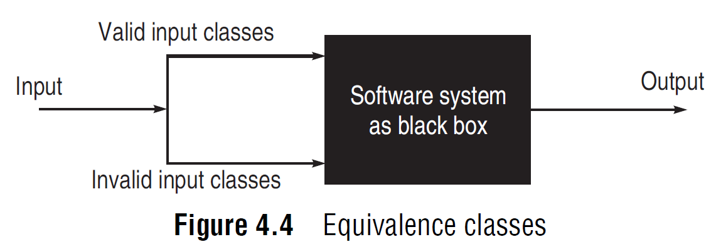
Identification of Equivalent Classes
There are no well-defined rules for identifying equivalence classes, as it is a heuristic process.

Slide 7
Identifying the Test Cases
Assign a unique identification number to each equivalence class.
Write a new test case covering as many of the uncovered valid equivalence classes as possible, until all valid equivalence classes have been covered by test cases.
Write a test case that covers one, and only one, of the uncovered invalid equivalence classes, until all invalid equivalence classes have been covered by test cases.

Slide 8
Identifying the Test Cases (cont.)
The reason that invalid cases are covered by individual test cases is that certain erroneous-input checks mask or supersede other erroneous-input checks. For instance,
if the specification states ‘Enter type of toys (Automatic, Mechanical, Soft toy) and amount (1–10000)’,
the test case [ABC 0] expresses two error (invalid inputs) conditions (invalid toy type and invalid amount)
the program may produce an output ‘ABC is unknown toy type’ and not bother to examine the remainder of the input.

Slide 9
Example 4.5
A program reads three numbers, A, B, and C, with a range [1, 50] and prints the largest number. Design test cases for this program using equivalence class testing technique.

Slide 10
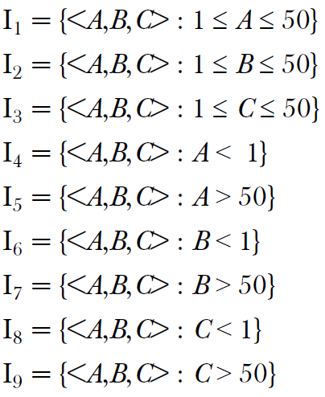
Solution
partition the domain of input as valid input values and invalid values

Slide 11
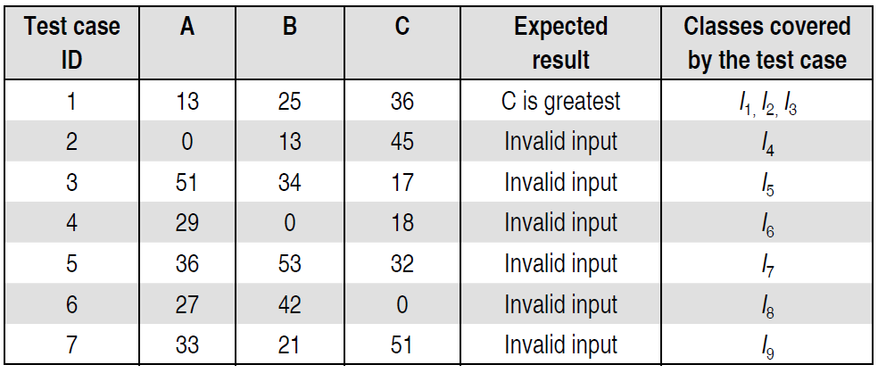
Solution
The test cases are shown below:

Slide 12
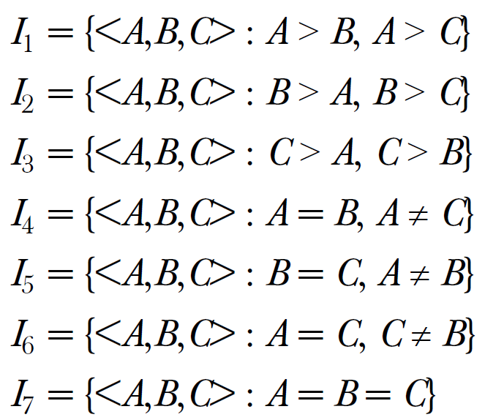
Alternative Solution
derive another set of equivalence classes based on some possibilities
for three integers, A, B, and C

Slide 13
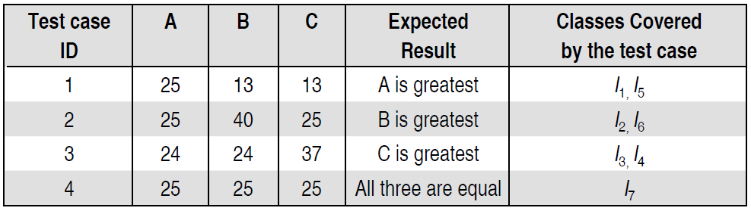
Alternative Solution
The test cases are shown below:

Slide 14
Example 4.6
A program determines the next date in the calendar. Its input is entered in the form of <ddmmyyyy> with the following range:
1 ≤ mm ≤ 12
1 ≤ dd ≤ 31
1900 ≤ yyyy ≤ 2025
Its output would be the next date or an error message ‘invalid date.’ Design test cases using equivalence class partitioning method.

Slide 15
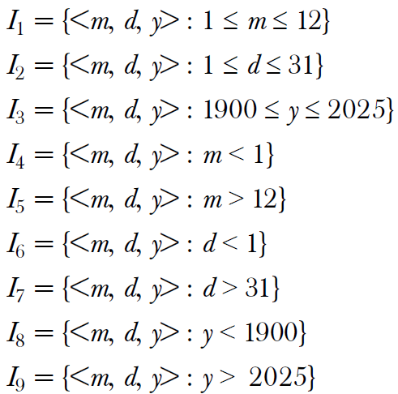
Solution
partition the domain of input as valid input values and invalid values

Slide 16
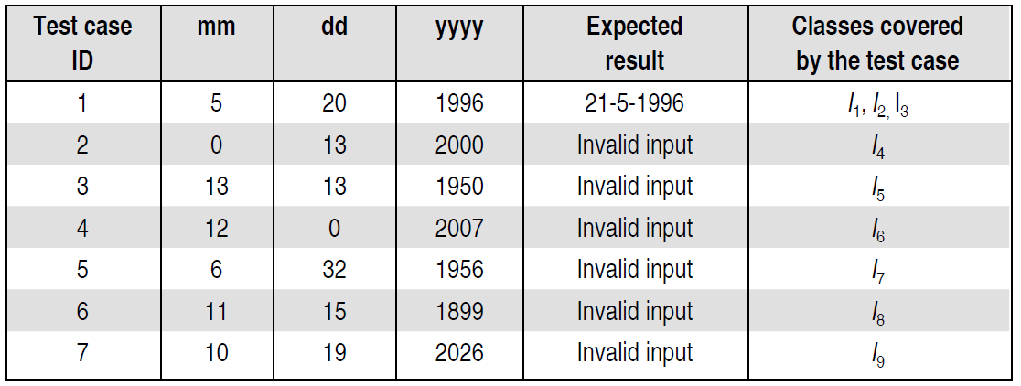
Solution
The test cases are shown below:

Slide 17
Example 4.7
A program takes an angle as input within the range [0, 360] and determines in which quadrant the angle lies. Design test cases using equivalence class partitioning method.

